Slide 1




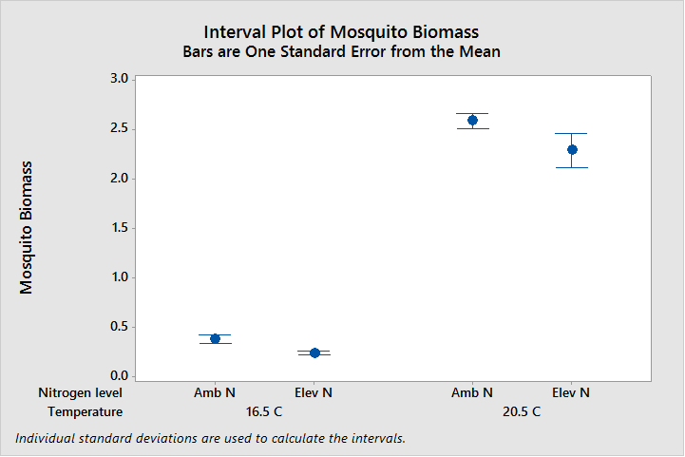
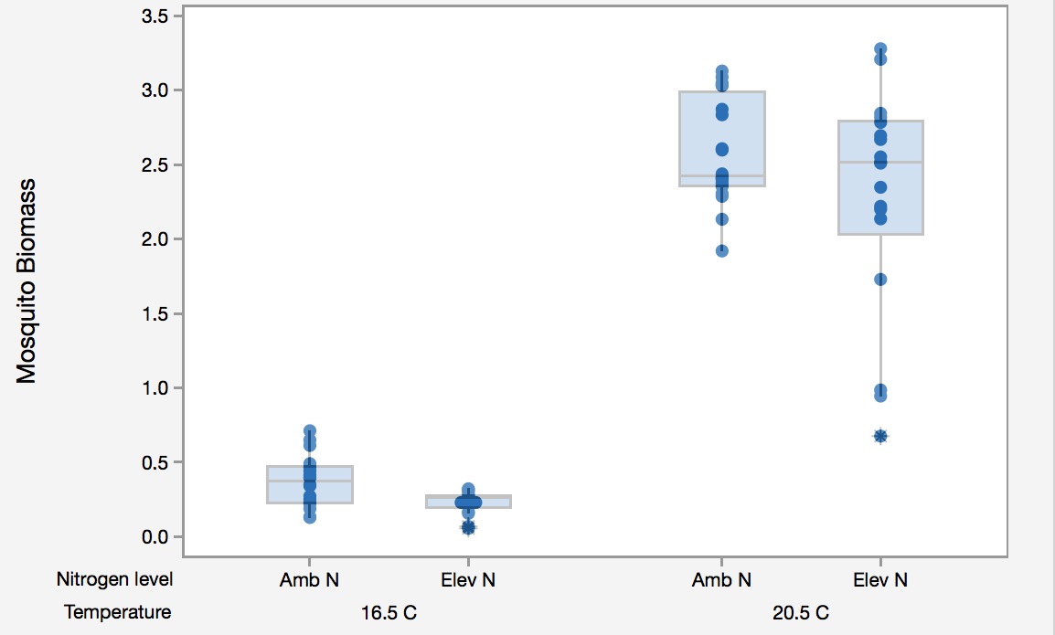
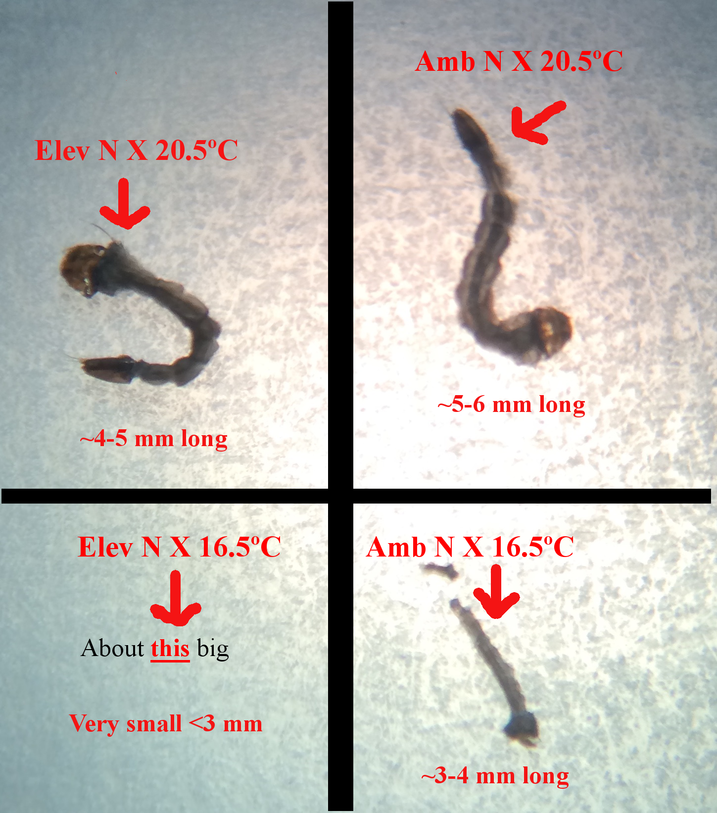
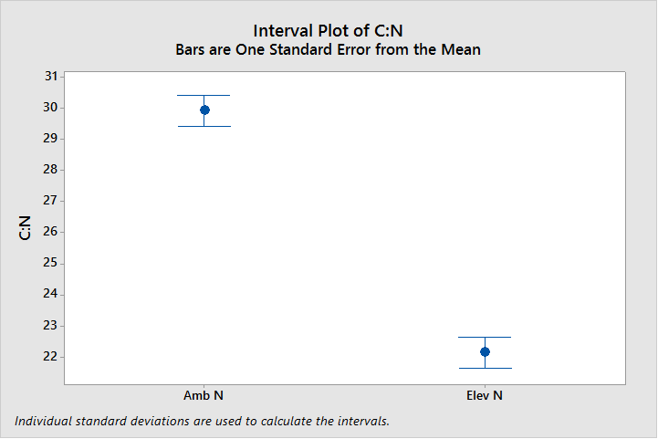
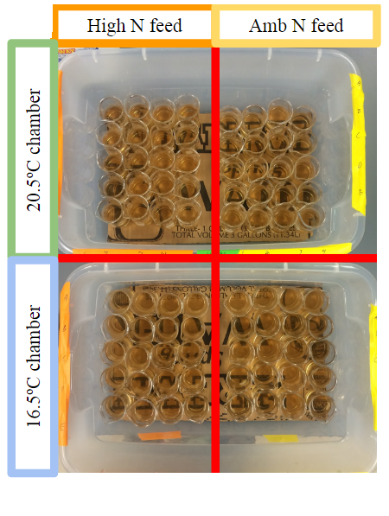
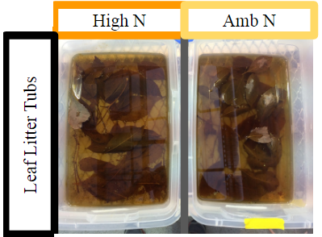
Bio 150.03
Effects of Climate
Change on Organisms
P. Jacobson
Effects of N-Enriched Leaf Litter and Decreased Temperatures on
Aedes aegypti Mosquito Larvae Development Time and Biomass
Place image of author here.
Place image of author here.
Place image of author here.
Brandon DeBella, Hye Sun Kim, Olek Yardas
ABSTRACT
Current trends of increasing global CO2 levels and average global temperatures will have significant effects on organisms. Mosquitoes are an organism of interest because they are a cosmopolitan group of disease vectors which infect and kill millions of people annually (Caraballo, 2014). Mosquito larvae are aquatic detritivores who feed on leaf litter and aquatic microorganisms, and who are sensitive to environmental changes. The positive effects of increased temperature and the negative effects of increased plant leaf litter C:N ratio are both well documented. While studies have been done investigating the interaction of these two variables on other aquatic detritivores, no such study has been done on mosquito larvae. We grew 80 Aedes aegypti larvae for two weeks to see if increased nitrogen levels and decreased temperature negatively affected their biomass, and our findings partially support this hypothesis. Climate change will effect mosquitoes like A.aegypti, but more research is needed to determine how this will effect its ability to transmit diseases.
RESULTS
\\
DISCUSSION
We hypothesized that increased nitrogen would increase larval biomass development rate, that decreased temperature would decrease larval biomass and development rate, and that the interaction of decreased temperature and increased nitrogen would cause decreased biomass and development rate. We observed decreased temperature having an extremely significant negative effect on biomass which supports our second hypothesis and is consistent with the findings of Rueda et al (1990), Tuchman et al (2003), Shelton (1973) and Strand et al (1999). However we also observed that decreased C:N leaf litter had a significant negative effect on biomass, which refutes our first hypothesis and is inconsistent with the findings of Tuchman et al (2003), who observed that increased C:N leaf litter had a negative effect on biomass. Our N-addition had a significant effect on leaf C:N with higher nitrogen supplementation decreasing C:N, which leads us to conclude that our method of N addition affected some other variable with negatively affected biomass. Our qualitative observations of mosquito development rate are consistent with those reported by Rueda et al (1990), Tuchman et al (2003), Shelton (1973) and Strand et al (1999). We did not observe a statistically significant interaction between temperature and nitrogen level on biomass.
Final larval biomass
(mg)
Figure 1A: Individual Value Plot overlaid by Box plot of of final larval biomass by N-level within temperature group (n=20).
Figure 1B: Mean larval biomass (n=20) [AmbNx16.5ºC mean=0.372mg, SE=0.1006]; [ElevNx16.5ºC mean=0.232mg, SE=0.1035]; [AmbNx20.5ºC mean=2.583mg, SE=0.09547]; [ElevNx20.5ºC mean=2.284mg, SE =0.1006]
INTRODUCTION
Atmospheric CO2 levels and average global temperatures are rising (IPCC, 2014) and this will undoubtedly have an affect on organisms and their ecosystems. The response of mosquitoes will affect humans, as mosquitoes are very effective vectors for lethal diseases (Caraballo, 2014). Mosquito larvae are heterotrophs so their development is not directly affected by increasing CO2 levels (Strand et al, 1999) but they are directly positively affected by increasing temperature (Rueda et al, 1990) (Shelton, 1973) (Strand et al, 1999). In still water microbial communities, leaf litter is the main source of nitrogen (Tuchman et al, 2002), which is cycled into the aquatic environment after senescence. Under limiting nutrients plants fix more carbon in higher CO2 levels, increasing plant C:N ratio. High C:N leaf litter hosts less microbial activity, decreasing leaf decomposition rate and microbial population size, which negatively affects mosquito biomass and survival rate (Rueda et al, 1990) (Tuchman et al, 2003) (Tuchman et al, 2002). While the intersection of rising [CO2] and temperature has been shown to negatively affect a species of winter mayfly (Ferreira et al, 2010), knowledge of the general affect on aquatic organisms including mosquito larvae has yet to be studied. We hypothesized that elevated levels of nitrogen in the mosquito’s leaf litter would have a positive effect on the biomass and development time of the larvae, decreased temperatures would have a negative effect on the development time of the larvae, and that both decreased temperatures and elevated nitrogen would have a negative effect on mosquito larvae biomass and development time
CONCLUSIONS
Our research shows that a changing climate will have an effect on mosquito biomass and development time. Further research is needed investigating how the effect of climatic variables on mosquitoes effect population activity on a larger scale, as well as effectiveness as disease vectors. Though this a more concrete path determining responses to mosquitoes as disease vectors in a changing climate can be reached.
ACKNOWLEDGEMENTS
The authors wish to thank Professor Peter Jacobson and Ashely Millet for their help in conducting this research. Thank you to Kevin Engel for acquiring papers that we otherwise would not be able to access.
Figure 2: A. aegypti larvae from each group after 24hrs in refrigerator
Figure 3: Mean C:N ratios within N-groups (n=3, T=11.06, p=0.0015); [AmbN C:N=29.9, SE=0.4978]; [ElevN C:N=22.1, SE=0.4910]
REFERENCES
Caraballo, Hector (May 2014). “Emergency Department Management Of Mosquio Borne Illness: Malaria, Dengue, And West Nile Virus.” Emergency Medicine Practice. 16 (5).
(2) Ferreira, Verónica, Gonçalves, Ana Lúcia, Gonçalves, Godbold, Douglas L., Canhoto,
Cristina (2010). Effect of increased atmospheric CO2 on the performance of an
aquatic detritivore through changes in water temperature and litter quality. Global
Change Biology, 16, 3284-3296.
(3) IPCC. (2014) Climate Change 2014: Synthesis Report. Contribution of Working Groups
I, II and III to the Fifth Assessment Report of the Intergovernmental Panel on
Climate Change [Core Writing Team, R.K. Pachauri and L.A. Meyer (eds.)]. IPCC, p26.
(4) Randlett DL, Zak DR, Pregitzer KS, Curtis PS (1996) Elevated atmospheric carbon
dioxide and leaf litter chemistry: Influences on microbial respiration and net nitrogen mineralization. Soil Science Society of America Journal, 60, 1571-1577.
(5) Rueda, L. M., Patel, K. J., Axtell, R. C., Stinner, R. E.(1990). Temperature-dependent development and survival rates of Culex quinquefasciatus and Aedes aegypti (Diptera Culicidae). Journal of Medical Entomology, 27 (5), 892-898.
(6) Shelton, Robert M. (1973). The effect of temperatures on development of eight mosquito species. Mosquito News, 33, 1-12.
(7) Strand, Mac, Herms, Daniel A., Ayres, Matthew P., Kubiske, Mark E., Kaufman, Michael G., et al. (1999). Effects of atmospheric CO2, light availability and tree species on the quality of leaf detritus as a resource for treehole mosquitoes. Oikos, 84, 2, 277- 83.
(8) Tuchman, Nancy C., Wahtera, Kirk A., Wetzel, Robert G., Russo, Nicole M., Kilbane, Grace M. et al. (2003). Nutritional quality of leaf detritus by elevated atmospheric CO2: effects on development of mosquito larvae. Freshwater Biology, 48, 1432- 1439.
(9) Tuchman, Nancy C., Wetzel, Robert G., Rier, Steven T., Wahtera, Kirk A., and Teeri, James A. (2002). Elevated atmospheric CO2 lowers leaf litter nutritional quality for stream ecosystem food webs. Global Change Biology, 8, 163-170.
We made qualitative observations throughout the experiment on the development stage of the mosquitos within each group. While there were no apparent differences in development stage between N-groups, we estimated that individuals in the 20.5ºC group were at the 4th or 5th instar at termination while individuals in the 16.5ºC group were at the 1st or 2nd instar at termination.
 | F value | p value
Temperature | 453.14 | <0.0001
N-groups | 4.80 | 0.0319
Temperature*N-groups | 0.62 | 0.4319
Table 1: ANOVA of larval biomass
METHODS**
80 Aedes aedgypti larvae
2x2 experimental design
Ash leaf litter cultured in tubs in greenhouse
50 mL 0.1M Ammonium Nitrate added to half of leaf litter, 1.6mL added after each feeding.
Mosquitoes grown in two incubators, 16.5°C and 21.5°C over two week period
Fed once per day, 0.15 mg of litter in 80mL of pond water blended. 1mL rations.
Factorial ANOVA used to analyze mosquito biomass.
Flash combustion elemental C:N analyzer used to determine C:N of leaf litter
T-test used to analyze variance of leaf litter C:N
** Due to time restrictions, we were unable to acquire leaf litter grown in CO2 enriched environments, so to simulate the inverse opposite effect, we instead enriched ash leaf litter with nitrogen in order to achieve a similar C:N ratio that would be found within leaf litter grown in CO2 reduced environments and using ambient levels of CO2 and C:N as controls. The reasoning is that by determining the response of mosquitoes to past environmental conditions we can predict the response of mosquitoes to future environmental conditions of increased CO2 and increased temperature, assuming that the curve of [CO2] and temperature are calculable functions.
Figure 4: Mosquito growth chambers
Figure 5: Leaf litter tubs

